Slide 1
Intelligent Classroom Monitoring System using Image Proccesing
Konada GopalaKrishna
(20010123)
Supervised by :
Dr.Rajkumari Bidyalakshmi Devi

Slide 2
Introduction
Motivation
Objective
The project aims to monitor the attendance and behavior of students and to detect instances that perturb the learning environment of a classroom such as drowsiness and mobile phone usage.
01
In-class Engagement
Drowsiness, distractions and mobile phone usage
02
Attendance
Disruption of class activities within the lecture duration
Notes:
For an effective classroom environment, it becomes important to track the activities and the state of the students taking the lecture. This becomes increasingly important owing to the difficulties faced by students and teachers in the transition from offline to online teaching due to the pandemic.
—-----
Online teaching ften leads to students being distracted. Engagement detection through drowsiness detection, mobile phone detection etc have been proposed to maintain the sanctity of a classroom
—-----
Studies show that student’s attendance has a strong positive correlation with their performance in classrooms [1], however, mid-class attendance along with factors such as inattentiveness of students often disturb a classroom. A considerable part of each lecture is spent recording students’ attendance.
—-----
The project aims to monitor the attendance and behavior of students and to detect instances that perturb the learning environment of a classroom such as drowsiness and mobile phone usage.

Slide 3
Overview
01
02
Real-time attendance
Drowsiness Detection
4
Deliverables
03
04
Gaze Detection
Mobile phone detection
Notes:
The proposed system has 4 major parts:
Real -time attendance - which uses facial recognition to identify a student and then save the attendance for a class in an excel spreadsheet
Drowsiness detection - uses computer vision to detect whether a person is sleepy or has his/her eyes closed, and displays a warning
Mobile phone detection - detects any mobile phones that are visible in the frame
Gaze detection - detects if any student is looking elsewhere or is distracted for a long period of time

Slide 4
Timeline and Progress
Semester 7
Semester 8
Attendance
Mobile Phone
Gaze
Drowsiness
Web App Development
Notes:
As for the project timeline, we plan to incorporate real-time attendance and drowsiness detection in this semester as a part of the minor project
—-----
and then extend the project by adding gaze and mobile phone detection, along with creation of a web interface for our major project in the next semester.

Slide 5
Real-time Attendance - Methodology
Attendance System
Register a new student
Identify and mark attendance
Notes:
The real-time attendance part of the system has 2 major components:
Registering a new student —-----
Identifying already registered students using facial recognitions and saving their attendance.
Let us take a deeper look at the components individually

Slide 6
Registering a new student
1
2
3
Enter
student
details
Capture
images of
the new
student
Retrain
model
Name and roll number for the new student are entered
The system clicks images of the new user.
The images are added to the database and the model is retrained
Notes:
Registering a new student has 3 main phases:
Enter student details - Initially the system takes the name and ID or enrolment number of the student as input. This ID will be used to identify the student later. —-----
Capture images - The system then proceeds to use the webcam to capture images of the student. OpenCV’s haarcascade object detection model has been used to extract faces from these images. These facial images are then saved in a training folder, marked by the name and ID. —-----
Finally, the face recognition model, namely Linear binary pattern histogram (LBPH) is trained using the image and ID pair and then saved.

Slide 7
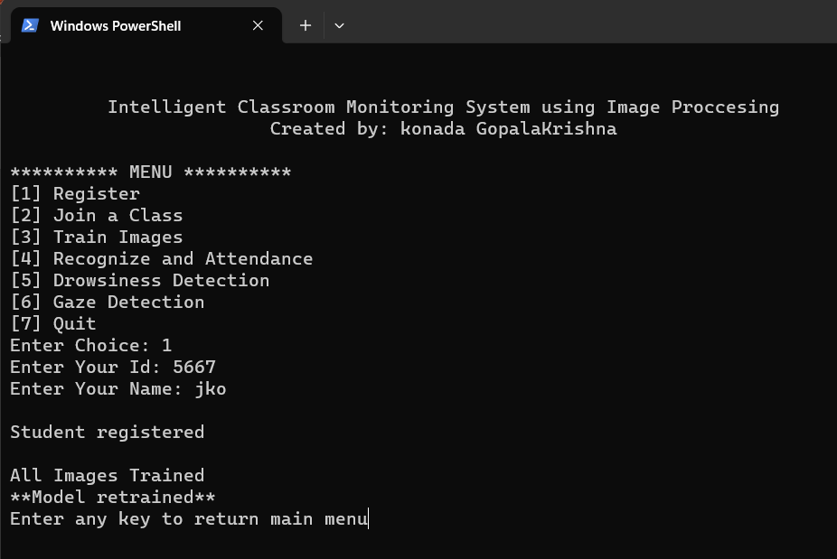
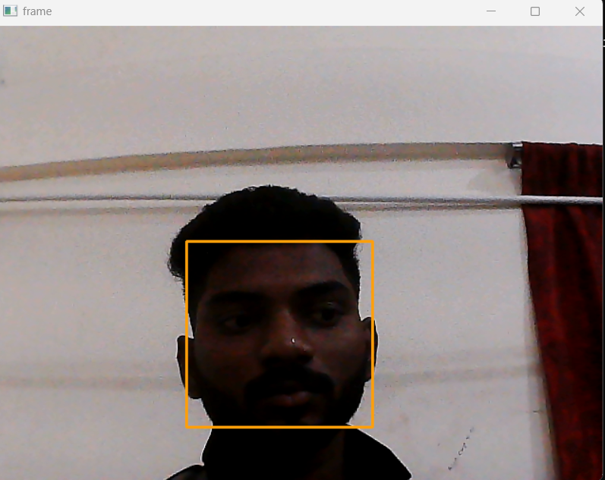
Registering a new student - Working
Fig:1
Fig:2
Entering student details
Capturing facial images
Notes:
The following slide shows the working of the first part of the smart attendance system.
First the student details are entered
Then face detection is used to save facial images

Slide 8
Identifying and marking attendance
1
2
3
Load the
trained
model
Identify student using
webcam or CCTV
Save attendance
in a CSV file
The most recently trained model is loaded
LBPH recognizer is used to identify the student in the frame
Student’s name, id, date and current time are saved in a csv file
Notes:
After a student is registered, the next phase is using facial recognition to identify the student and mark their attendance. This is done in 3 parts
—-----
Initially the saved model i.e. the LBPH recognizer is loaded.
—-----
Then the OpenCV haarcascade face detection followed by the LBPH recognizer are used to first detect the face of the student and then recognize him/her and returning their ID.
—-----
Finally, the Student’s name, id, date and current time are saved in a csv file

Slide 9
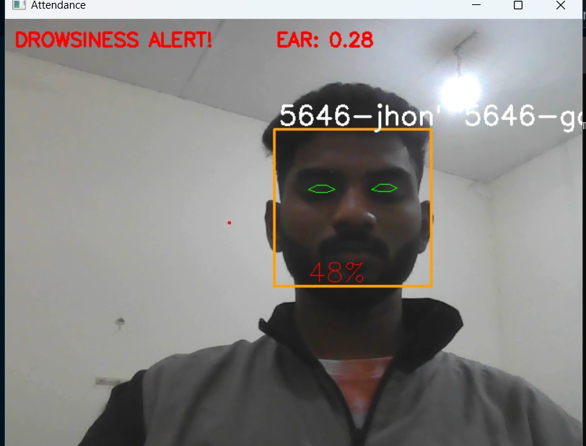
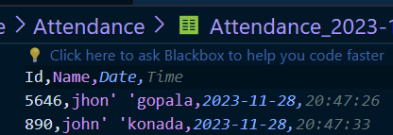
Identifying and marking attendance - Working
Fig:4
Fig:3
Identifying using face recognition
Marking attendance and saving it as a CSV file
Notes:
The following slide shows the working of the second part of the smart attendance system.
First the student is identified using face recognition
Then their attendance is displayed and saved as a CSV file

Slide 10
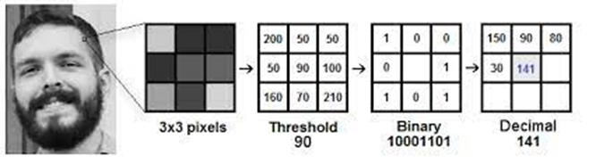
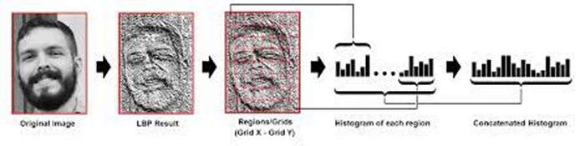
Linear Binary Pattern Histograms (LBPH) for Face Recognition
Thresholding
Converting to histograms
Notes:
The following slide delves into the LBPH algorithm which has been used for facial recognition. Local Binary Pattern (LBP) is a simple yet very efficient algorithm which labels the pixels of an image by thresholding the neighbourhood of each pixel. Moreover, it allows us to represent facial images using simple data vectors. The algorithm consists of 2 major parts,
—-----------
Thresholding - in this phase, a sliding window is used to create an intermediate image that highlights the face better than the original image. This is achieved by using the central pixel of the window as a threshold and then converting the remaining pixels into a binary number.
—-----------
Converting to histograms - the resultant image is then divided into grids and each of the cell of this grid is converted into a histogram based on the intensity of the pixels. All the histograms are combined to give the final representation of the initial image. This makes recognition very easy as the system now has to just compare the histograms to identify a person.

Slide 11
Drowsiness detection
Detect
eyes
Calculate eye aspect ratio
Print warning
If drowsy
Eyes are detected using dlib’s facial landmarks
Average eye aspect ratio is calculated using euclidean distance
If EAR is below threshold, warning is printed on screen
Notes:
Drowsiness detection is also performed by the system using the student’s webcam video stream. This process has 3 stages
—------
Initially, the face of the student is detected. Following this, Dlib’s 68 facial landmarks model has been used to detect the eyes of the person in the frame
—------
Next, the coordinates of the eyes are retrieved, and the EAR which indicates the ratio of the vertical opening of eyes to the horizontal eye length is calculated for both the eyes. The 2 EAR values are then averaged to get the final value
—------
Finally, the EAR is compared to a certain threshold value. If the EAR is greater than the threshold, the person’s eyes are open. If not, the system detects that the eyes are closed. To avoid false alarms due to blinking, drowsiness is reported only if the eyes are closed for a certain period of time.

Slide 12
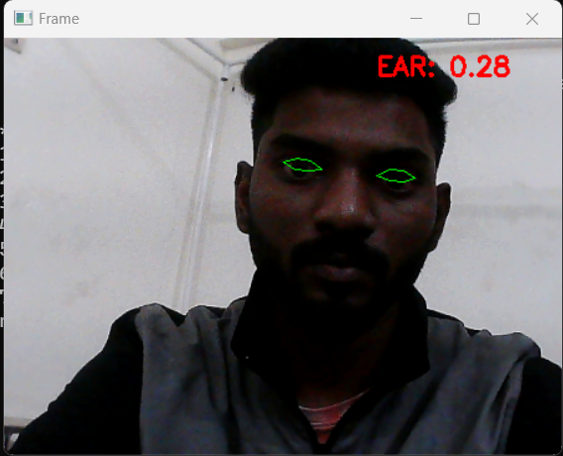
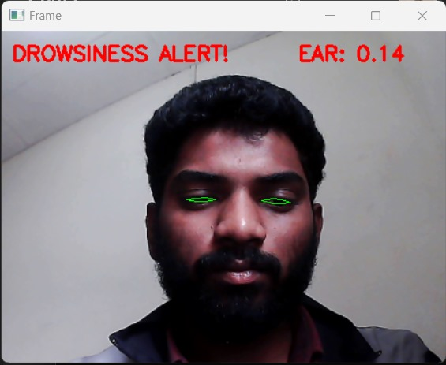
Drowsiness detection - Working
Fig:5
Fig:6
Drowsiness not detected
Drowsiness detected
Notes:
The following slide shows the working of Drowsiness detection.
—--------
First image shows the result when the eyes are open
—-------
And the second image shows the result when the eyes are closed

Slide 13
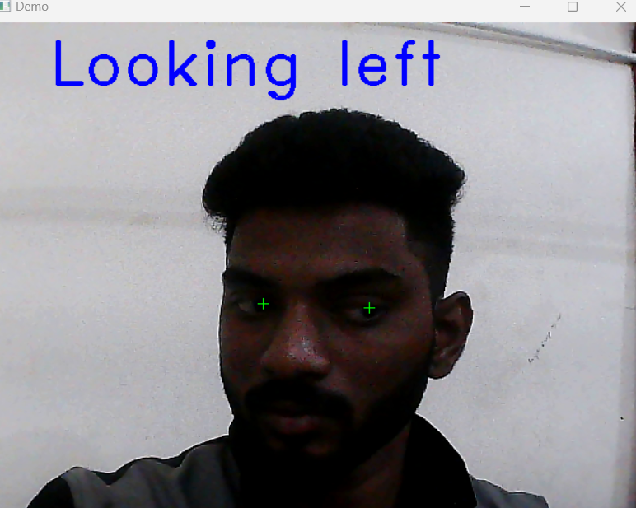
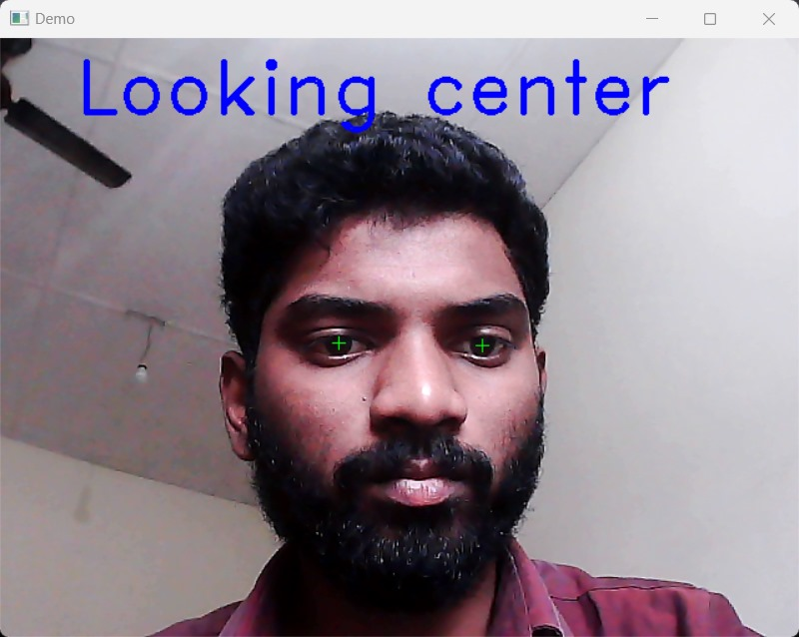
Gaze detection
Fig:8
Fig:7

Slide 14
Current project workflow
Enter student details
Register student
Capture student images
Intelligent Classroom Monitoring System using Image Proccesing
Automatic attendance
Join a meeting
Drowsiness detection
Notes:
The following slide shows the workflow of the project.
—--------
—--------
On starting the system, the user has 2 choices - to register a student and to join a meeting. The join a meeting option allows the user to use both smart attendance and drowsiness detection at the same time.
—--------
On registering a student, the model first proceeds to ask for the student details, namely the id and name. This is followed by capturing of images and retraining of the model.
—--------
Joining a meeting allows the user to concurrently use both the functionalities i.e., the system will mark their attendance and also detect for any signs of drowsiness

Slide 15
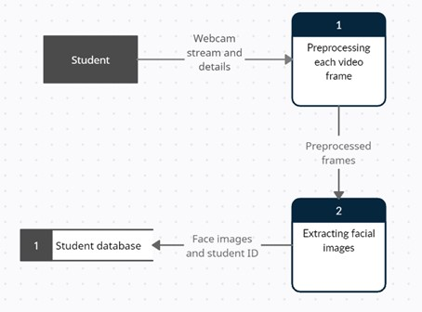
Dataflow Diagram

Slide 16
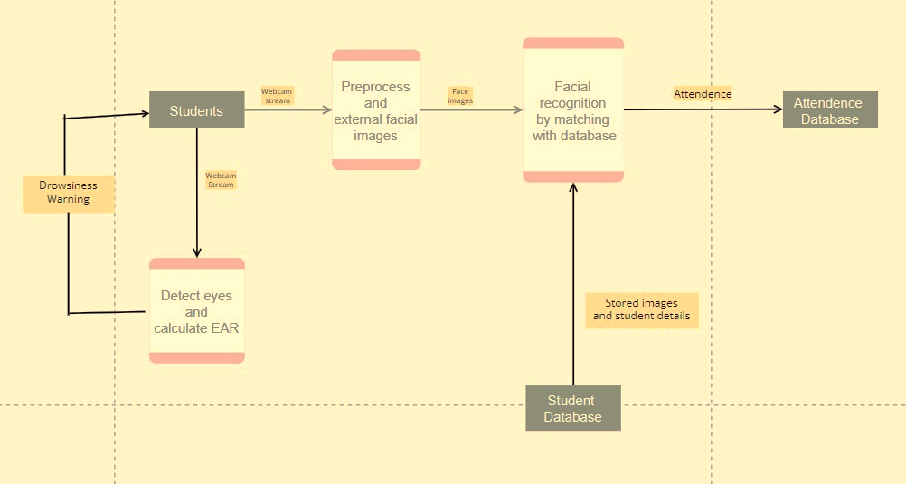
Attendance Architecture
Fig:9

Slide 17
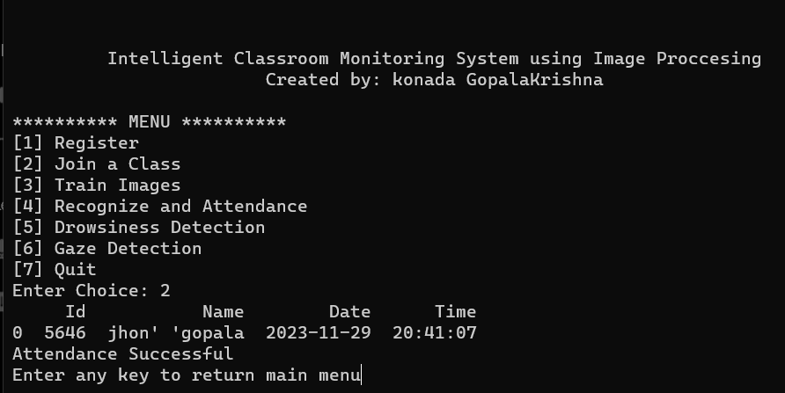
Interface
Fig:10

Slide 18
Conclusion
The Smart Attendance System is a robust solution for improving attendance tracking, enhancing student engagement, and promoting a more productive learning environment.
The system's capabilities can be further enhanced through future research and development

